Slide 1
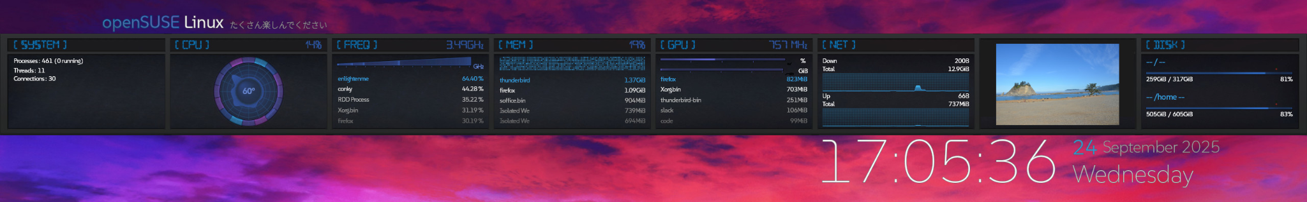
Introducing Conky Bubbles
Simon Lees
sflees@suse.de / simon@simotek. net
https://github.com/simotek/conky-bubbles
Notes:
https://github.com/anoek/ex-sdl-cairo-freetype-harfbuzz/tree/master
https://github.com/brndnmtthws/conky/pull/1501
file:///home/simon/src/devel/conky-bubbles/docs/index.html

Slide 2
This talk
What is Conky
Why do we need this new project
How to work with other existing open source projects
Font rendering

Slide 3
About Me
Contributing to open source for 15 years
Packaging for Linux Distros for a similar amount of time
Hobbies include UI Design and Customisation

Slide 4
Why?

Slide 5
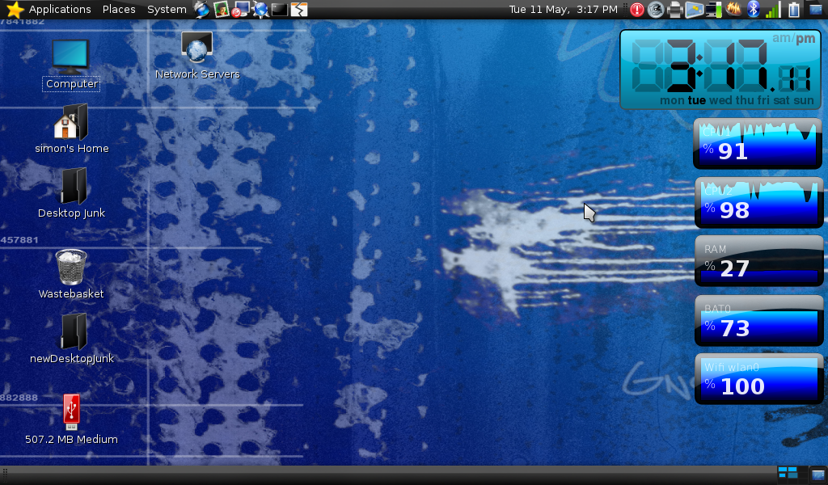

Slide 6
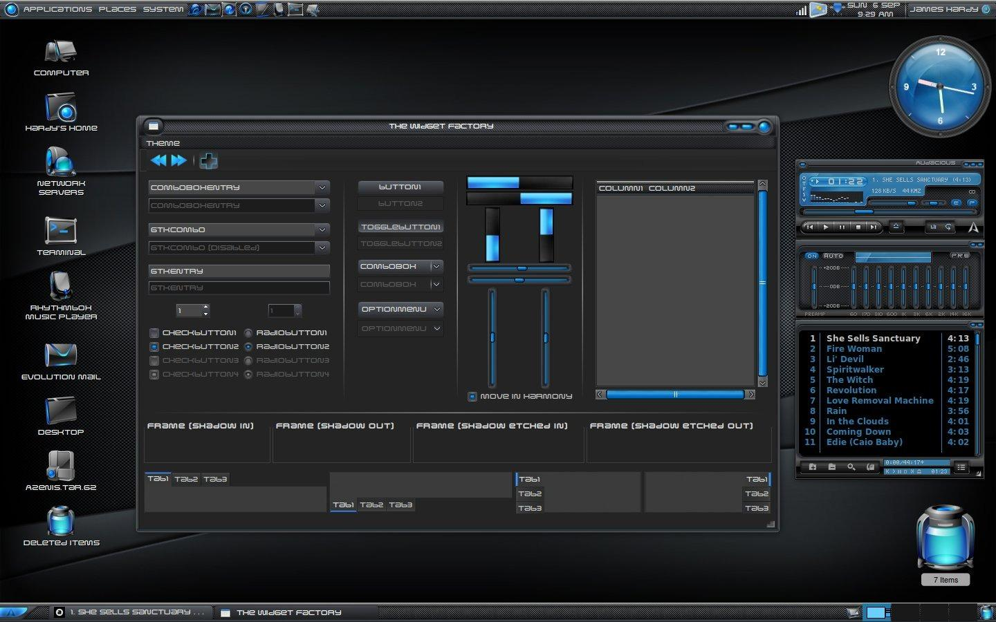

Slide 7
Why?
This project started properly 6+ years ago during SUSE’s Hackweek to provide a better out of the box system monitor for the desktop.
But I have probably been working on it significantly longer

Slide 8
What is conky?

Slide 9
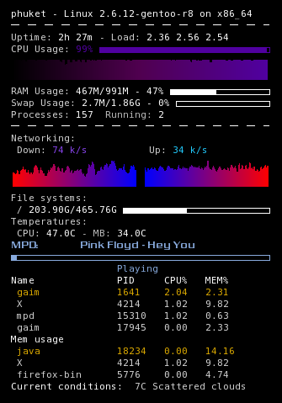
Default

Slide 10
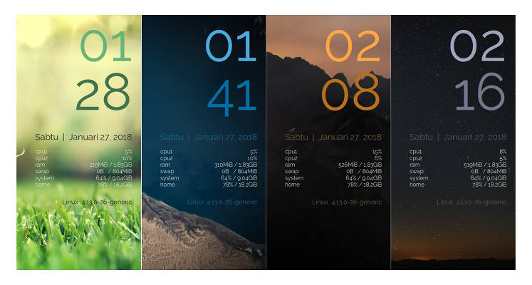
Can look like

Slide 11
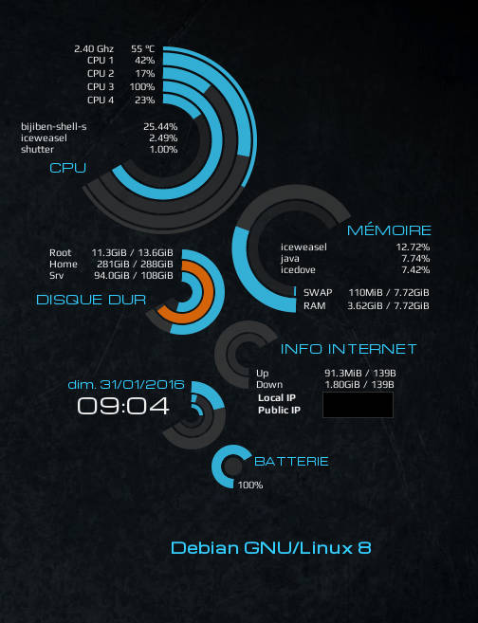
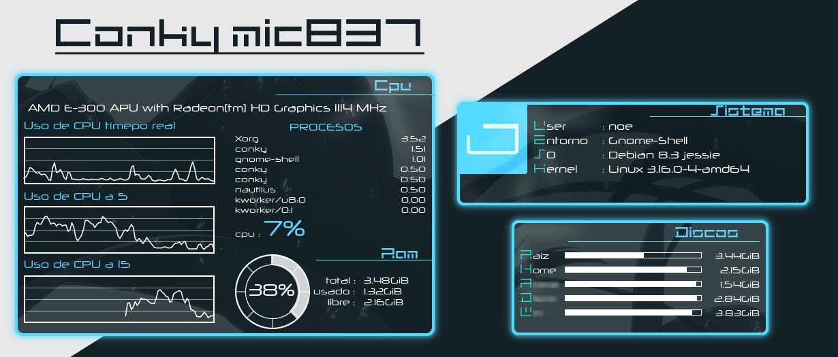
Can look like

Slide 12
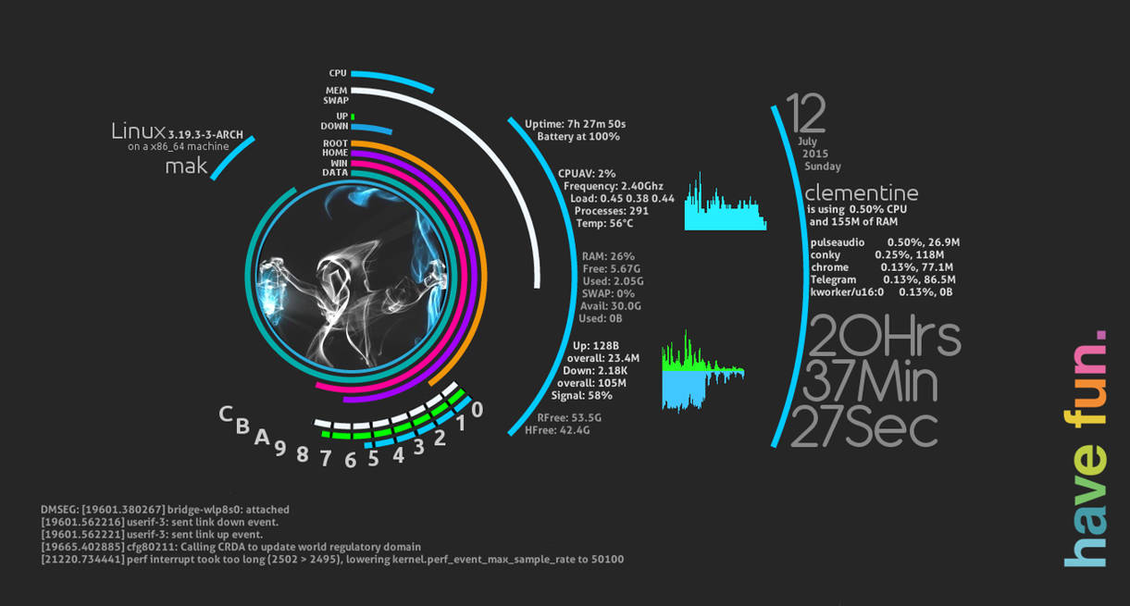
Can look like

Slide 13
Why do we need something else?

Slide 14
Why?
Conky Configs are very machine specific
Hard to share across multiple machines
Even harder for a distribution to provide meaningful defaults

Slide 15
Appearance
Can look dated out of the box compared to what is possible
Styling is hard
Changing a font requires manually repositioning everything

Slide 16
Why use conky at all?
The System monitoring works really well, wide range of variables
Lua integration makes it easy to expand

Slide 17
Goals

Slide 18
Goals
Work out of the box in Linux Distro’s
Automated hardware detection
Theme engine
Better layout handling

Slide 19
What already exists?

Slide 20
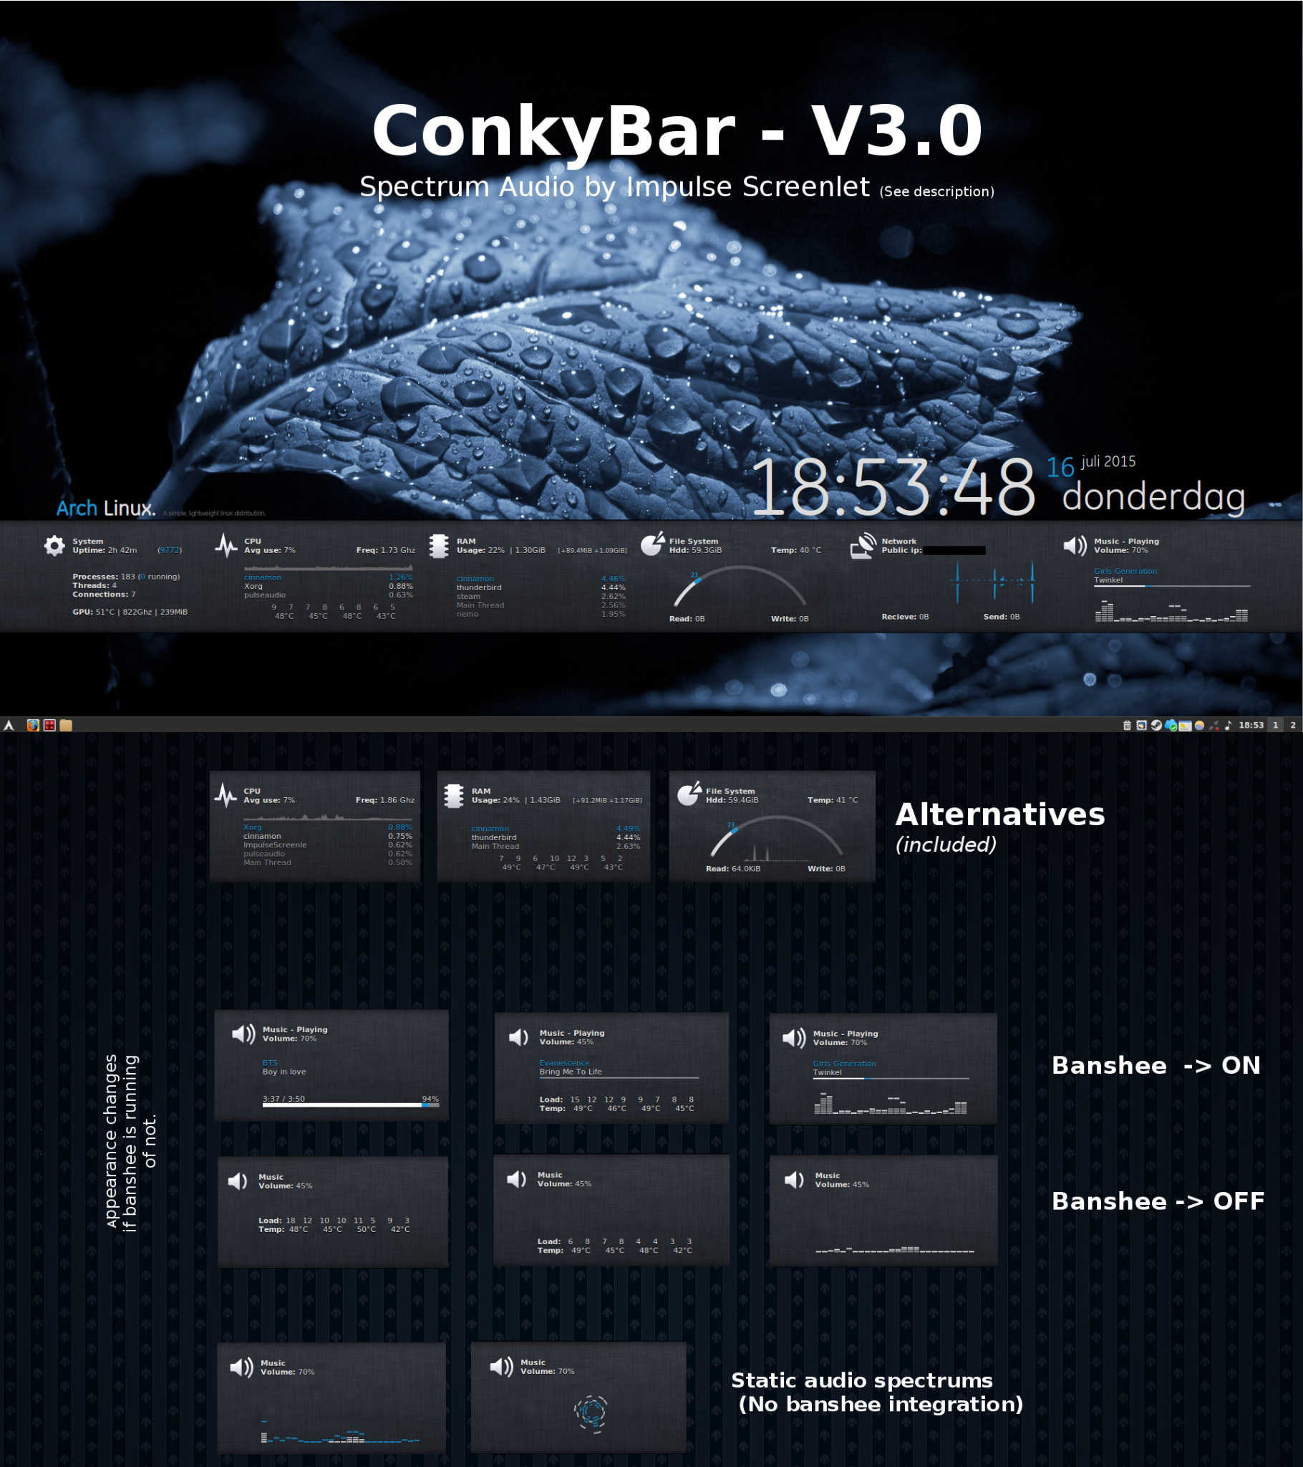
Option 1

Slide 21
Option 1
https://www.deviantart.com/n00by4ever/art/ConkyBar-Conky-config-Conky-1-9-549312244
Had used it before
Uploaded once to deviant art
Just enough scripting and Lua to be code rather then config
No license
Icons and fonts weren't licenced for commercial use
Solved some problems using multiple conky instances

Slide 22
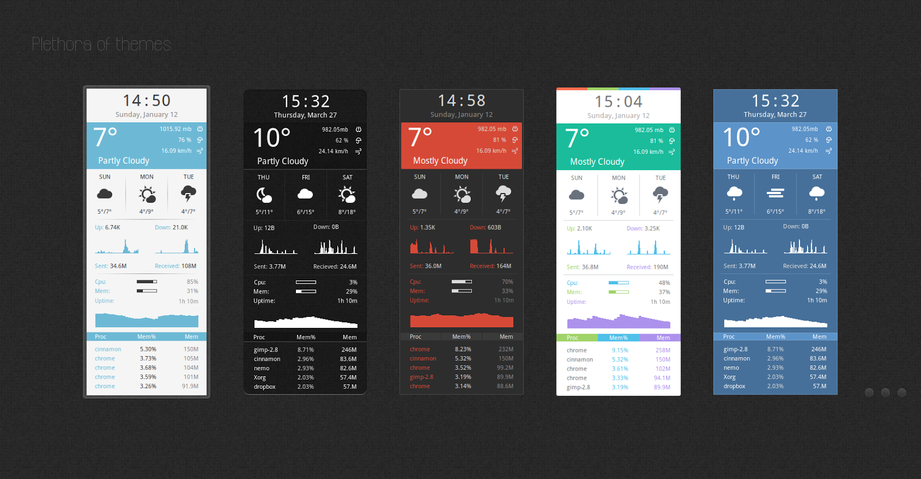
Option 2 - Harmattan

Slide 23
Option 2
https://github.com/jonasjuffinger/Harmattan
Looks nice
Open source licensed
Doesn't solve the hardware detection problem
Doesn't solve the layout issues

Slide 24
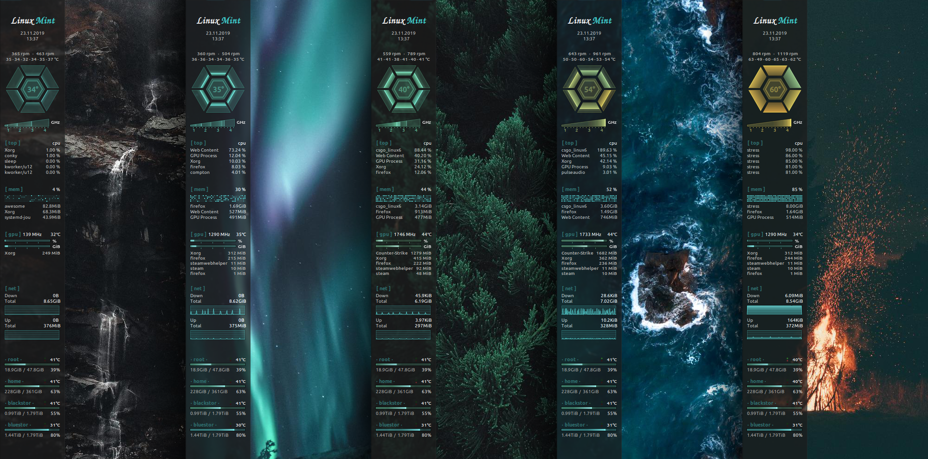
Option 3 - polycore

Slide 25
Option 3 - polycore
Layout engine
Cool widgets
Extensive Lua libraries
No license (yet)
Still used conky’s traditional text

Slide 26
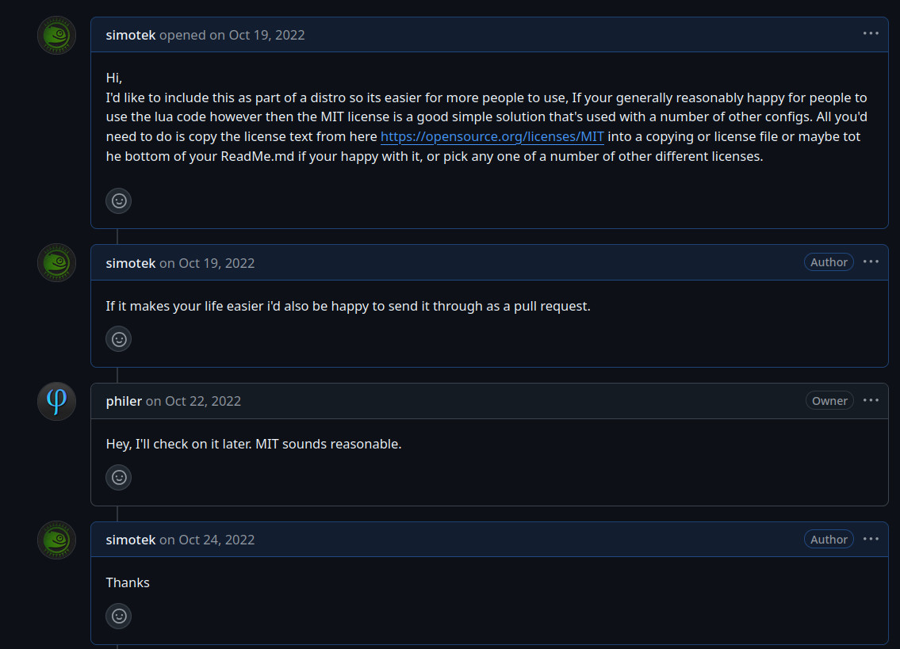
Option 3 - polycore
Fixing the License issues
https://github.com/philer/polycore/issues/5

Slide 27
Font Rendering

Slide 28
Freetype / Harfbuzz / Cairo
https://github.com/anoek/ex-sdl-cairo-freetype-harfbuzz/
https://github.com/brndnmtthws/conky/pull/1501
Notes:
https://github.com/anoek/ex-sdl-cairo-freetype-harfbuzz/tree/master
https://github.com/brndnmtthws/conky/pull/1501

Slide 29
When is it time to fork a project?

Slide 30
Why fork
Aims and goals no longer align
elopment cycle differencesDifferences in developer time

Slide 31
Introducing conky-bubbles

Slide 32
conky-bubbles
Conky was named after a character in the Trailer Park Boys
A wiki suggested that Bubbles, was conky’s helper.

Slide 33
conky-bubbles
Features
Improved layout engine with sandboxing
Widgets render text using the new text API
Theme Engine
Dimensions
pcore2

Slide 34
Still to do
More Themes
Further Improve hardware detection
More Widgets
Launcher

Slide 35
Compiling conky
mkdir build; cd build
cmake .. -G Ninja -DCMAKE_INSTALL_PREFIX=/opt/conky -DBUILD_APCUPSD=ON -DBUILD_ARGB=ON -DBUILD_CURL=ON -DBUILD_DOCS=OFF -DBUILD_EVE=ON-DBUILD_GUI=ON -DBUILD_HDDTEMP=ON -DBUILD_HTTP=OFF -DBUILD_I18N=ON -DBUILD_IBM=ON -DBUILD_ICAL=OFF -DBUILD_ICONV=ON -DBUILD_LUA_CAIRO=ON -DBUILD_IMLIB2=ON -DBUILD_LUA_IMLIB2=ON -DBUILD_LUA_RSVG=ON -DBUILD_LUA_TEXT=ON -DBUILD_IOSTATS=ON -DBUILD_IPV6=ON -DBUILD_MATH=ON -DBUILD_MOC=ON -DBUILD_MYSQL=OFF -DBUILD_NCURSES=ON -DBUILD_NVIDIA=ON -DBUILD_PORT_MONITORS=ON -DBUILD_PULSEAUDIO=ON -DBUILD_RSS=ON -DBUILD_OLD_CONFIG=ON -DBUILD_WEATHER_METAR=ON -DBUILD_WEATHER_XOAP=ON -DBUILD_WLAN=OFF -DBUILD_X11=ON -DBUILD_XDAMAGE=ON -DBUILD_XDBE=ON -DBUILD_XFT=ON -DBUILD_XSHAPE=ON -DOWN_WINDOW=ON -DBUILD_XMMS2=OFF
ninja; ninja install

Slide 36
Questions
https://github.com/simotek/conky-bubbles

Slide 37
Spec Files - Example
https://build.opensuse.org/package/show/devel:languages:python/python-bytecode
https://build.opensuse.org/package/show/devel:languages:python/python-autobahn

Slide 39
Step 1: Understand your Package

Slide 40
Step 2: Try and find a similar Package

Slide 41
Autogenerate
For some languages such as python there are tools to autogenerate a spec file
You can also create a empty spec file with tools like “vim foo.spec”

Slide 42
Branch or Create
If we are working on a package that already exists we can branch it into our home project
Otherwise we need to create it.

Slide 43
Finding The right version
Browse to openSUSE:Factory
https://build.opensuse.org/project/show/openSUSE:Factory
Use the filter to find the package you want
Select the package
At the top right look for Developed at XXX
This will give you the devel project.
Click on it
Select Branch Package on the Left.

Slide 44
Creating a Package
Browse to your home project (not mine)
Shortcut on Left Bar
https://build.opensuse.org/project/show/home:simotek
Using osc
osc co project
cd project
osc mkpac name
cd name

Slide 45
Step 3: Building

Slide 46
Working Locally
First we need to checkout the package
osc co project/package
Then we can work with the files locally
To add / remove files from the project
osc ar (Similar to git add)
Commit changes when done
osc commit Similar to git commit + git push

Slide 47
Building
First configure repositories.
https://build.opensuse.org/repositories/home:simotek
osc build repo
The buildservice will automatically build any enabled packages.

Slide 48
Step 4: Contributing

Slide 49
Contributing
Send from “home” project to “devel” project
“devel” project maintainer will send it to Tumbleweed
You can then send it to the next Leap
This can be done either with a submit request from the webui or on the command line with osc sr

Slide 50
Staging Dashboard
https://build.opensuse.org/staging_workflows/openSUSE:Factory

Slide 51
Maintenance
Sometimes we need to change a package in an existing Leap distribution
osc mbranch and osc sr when done

Slide 52
2 Minutes of Advanced Concepts

Slide 53
Constraints
Specifies minimum requirements for a builder
_constraints file
https://openbuildservice.org/help/manuals/obs-user-guide/cha.obs.build_job_constraints.html
Example
https://build.opensuse.org/package/view_file/LibreOffice:Factory/libreoffice/_constraints?expand=1

Slide 54
rpmlintrc
Rpmlint does a good job of finding issues in packages sometimes it creates false positives though
<packagename>-rpmlintrc file
https://en.opensuse.org/openSUSE:Packaging_checks
Example: https://build.opensuse.org/package/show/Base:System/python-dbus-python

Slide 55
Supplements
You have a vim plugin for Rails, or a
Squid plugin for yast
Supplements: (A and A-Client)
Supplements: (vim and ruby-common-rails)

Slide 56
Multibuild
Build multiple packages from the same spec and source
_multibuild file
https://openbuildservice.org/help/manuals/obs-user-guide/cha.obs.multibuild.html
Example: https://build.opensuse.org/package/show/devel:tools:building/cmake

Slide 57
Project Config
Used to define settings between different Distributions along with some rpm macro’s

Slide 58
Language files
Header
%lang_package
Install
%find_lang %{name}
Files
%{?suse_version:%files lang -f %{name}.lang}
Example
https://build.opensuse.org/package/view_file/X11:Enlightenment:Factory/terminology/terminology.spec?expand=1

Slide 60
Packaging Workshop
A Hackweek Experement
Simon Lees
Simotek
sflees@suse.de / simon@simotek. net
https://en.opensuse.org/openSUSE:ALP/Workgroups/GrassyKnoll
Simotek on irc.libera.net / Discord
@Simotek_Dot_Net

Slide 61
Getting Started
Create an account at https://idp-portal.suse.com/univention/self-service/#page=createaccount if you don’t have a bugzilla / obs / openSUSE Community account.
Install patterns-devel-osc-devel_osc_build (This should work with a WSL Image as well)
osc co home:<your-user>

Slide 62
What are we doing?
Has anyone done packaging before?
Has anyone got any questions or something they’d like to look at?
We can also look at building Images if you’d like.

Slide 63
Breaking a Package
Add a file that doesn’t exist
Remove one that does
Make a typo in a macro name

